Slide 1
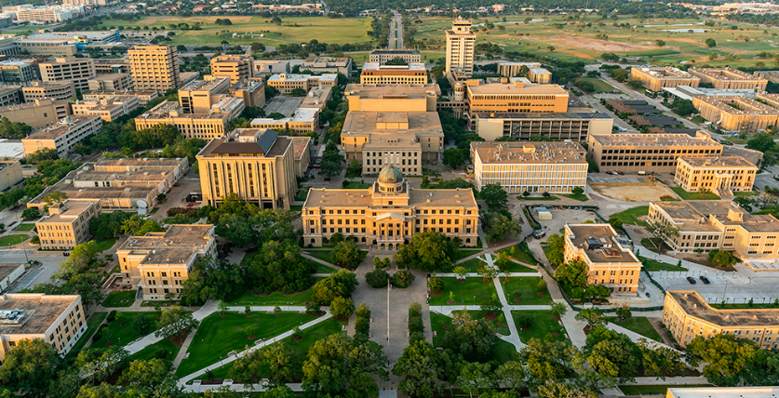
Texas A&M University Blue Emergency Phones Locator Project
Mackenzie Portie
Nichole Mendez
Alex Aquino
Roberto Duran
Destiny Sanchez

Slide 2
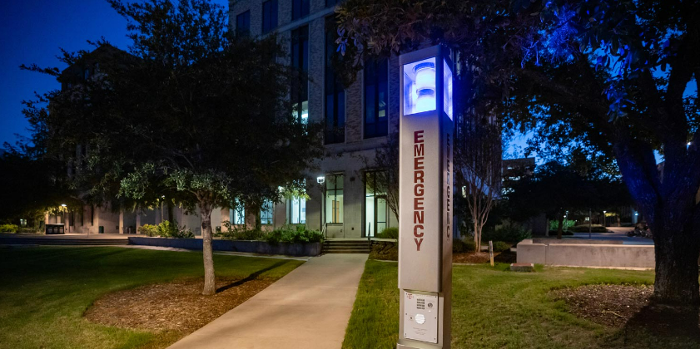
Goal
What were you planning to do?
Our group is planning on locating the Blue Light Emergency phones on Texas A&M University main campus and creating a webpage regarding the information about them.
Notes:
Mackenzie

Slide 3
Motivation
Why were you planning to do it, for whom, to solve what problem?
Improve campus safety
By creating an interactive map that shows where the Blue Light Emergency phones are located on the main campus
This provides easy access that can be used by students, faculty, staff, and visitors in case of an emergency
Map can be personalized according to the locations the user is primarily at
Provide accessibility
The webpage we will create, will include more information about these emergency systems such as their location, functionality, and other resources
This promotes emergency preparedness to allow for effective response to be taken during an emergency
Notes:
Nichole

Slide 4

Approach/Methods/Data
Planning on using ArcGIS Field Maps as our main application to locate the Blue Light Emergency Phones.
After the Emergency Phones have been located and mapped, a website will be created using HTML and JavaScript.
This webpage will hold information about the specifics of the Emergency Phones and nearest location to known places on campus.
Notes:
Alex

Slide 5

Results
No results as of yet but we hope to achieve a compilation of data and information that is applicable to our goal.
This data will aid us in creating our website to make sure we have accurate information for the public regarding the emergency phones located around campus.
Notes:
Roberto

Slide 6
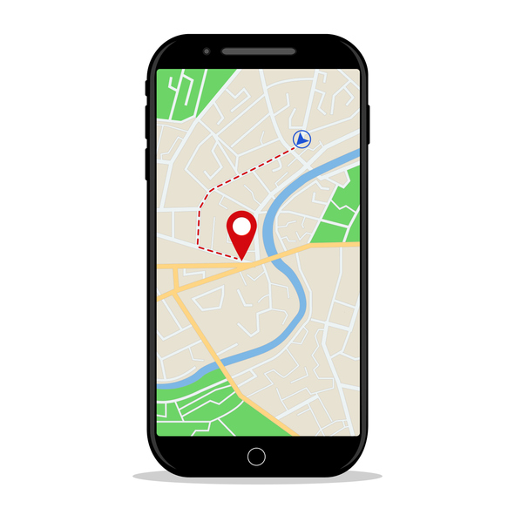
Discussion/Conclusion
We hope to create a more accessible and user friendly map/website to ensure the safety of everyone on campus and promote emergency preparedness.
Notes:
Destiny

